Slide 1


Lane Detection in Low Light Conditions Using Hough Transform and Retinex Method
Presented by
Chaitanya R. Nimbargi (24365)
Suvam Dey (24290)

Slide 2
Introduction
Objective:
To test the impact of different light conditions on lane detection algorithm (Hough transform)
To quantify the impact of image enhancement and preprocessing steps on lane detection algorithm (Hough transform)

Slide 3
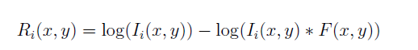
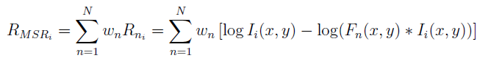
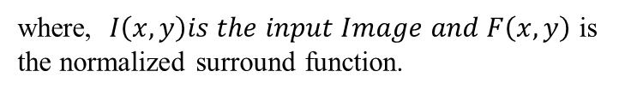
Multiscale Retinex
Multiscale retinex is basically the weighted sum of single scale retinex having different scales.
Enhances image details by combining multiple scales of illumination correction to improve contrast and dynamic range.
Utilizes Gaussian filters at different scales to process the image, combining the results logarithmically to mimic human vision.
where, $I\left(x,y\right)is the input Image and F\left(x,y\right)$ is the normalized surround function.
This is the weighted sum of SSR.

Slide 4
Progressive Probabilistic Hough Transform (PPHT)
Hough transform attempts to detect geometric shapes (like lines or circles) using parametric representation, mapping to a parametric space in the accumulator for voting.
Processes all edge points – computationally expensive and leads to noise.
PPHT dynamically adapts the number of points used during voting, reducing computation.
Utilizes the fact that longer lines require fewer points to be reliably detected
Outputs line segments

Slide 5
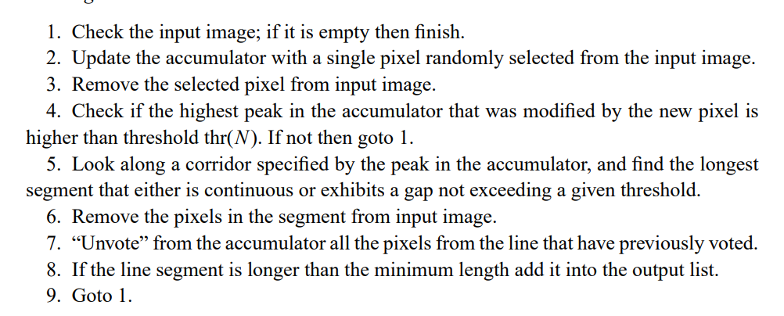
PPHT Algorithm
Algorithm

Slide 6
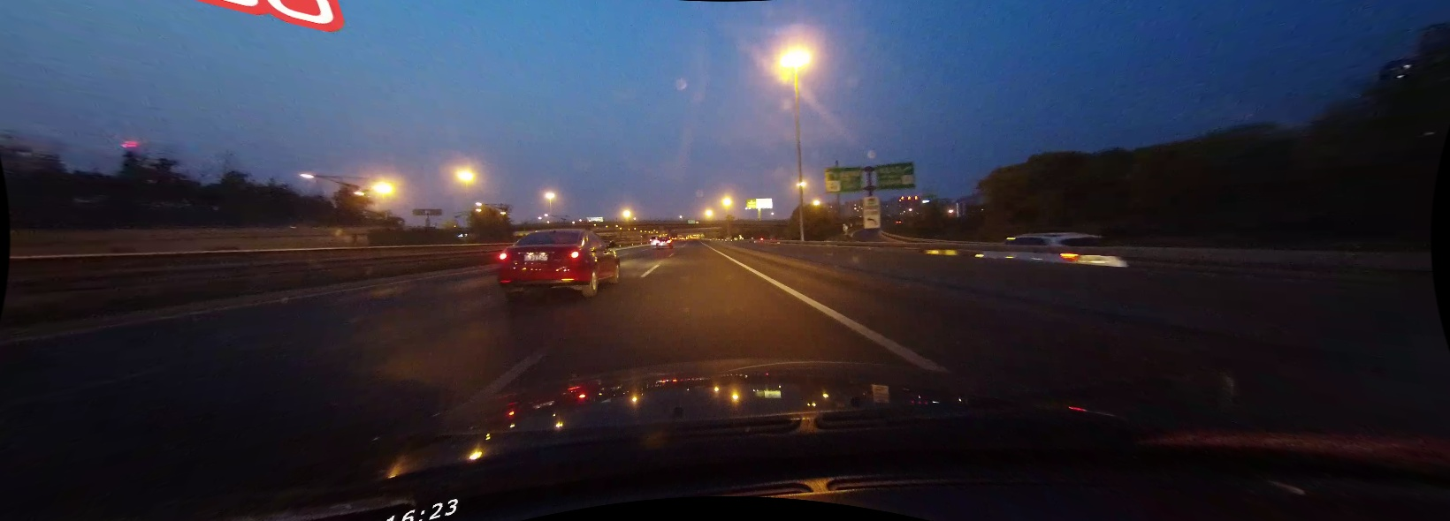
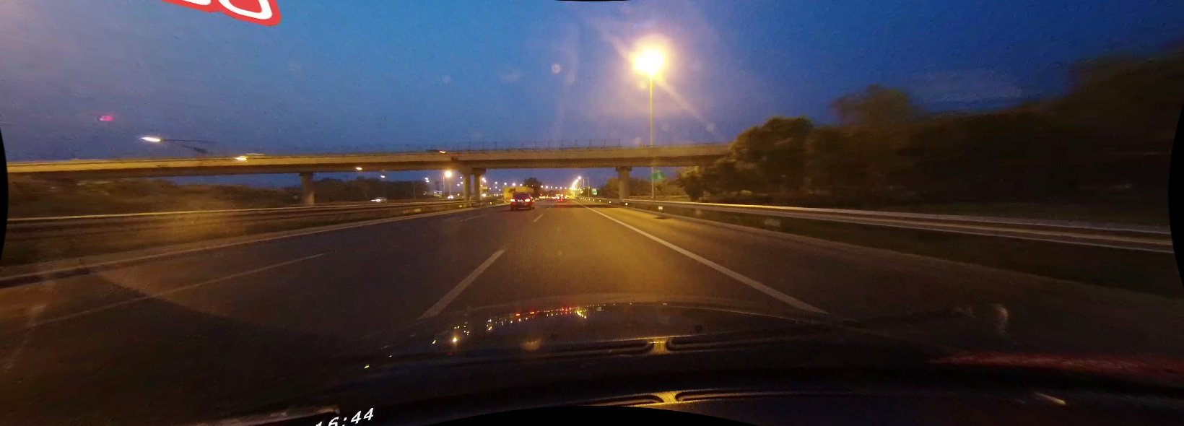
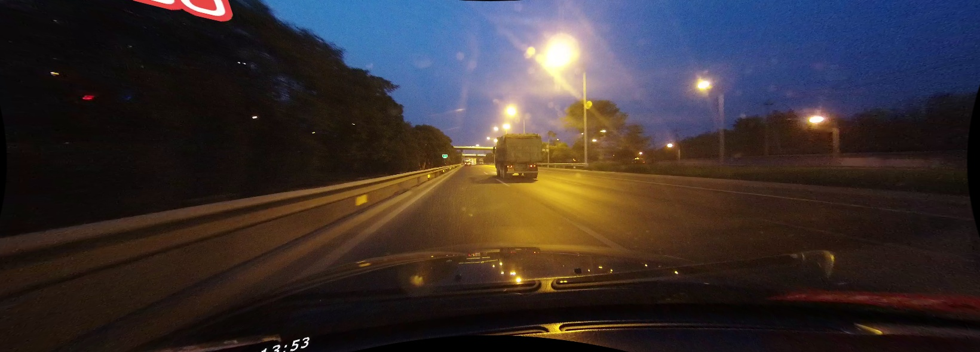
Dataset: CuLane
CULane is a large scale challenging dataset for academic research on traffic lane detection. It was collected by cameras mounted on six different vehicles driven by different drivers in Beijing. The lanes are annotated with the annotations also made available.
Most images are captured in daylight, but we identified 60 images captured by one camera of night light images, and this was used for our analysis.
Some sample images have been shown

Slide 7
Processing Sequence
Read Image
Detect if Night Image
Convert to GrayScale
Apply image smoothening filter (Gaussian) for Noise Reduction
Apply Edge Detection (Canny)
Define Region of Interest and Apply Mask
Detect Lines Using Probabilistic Hough Transform
Get Accuracy by Comparing with Annotation
No
Yes
Apply Retinex Method on Image

Slide 8
Results

Slide 9
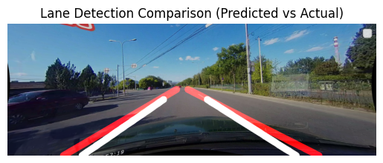
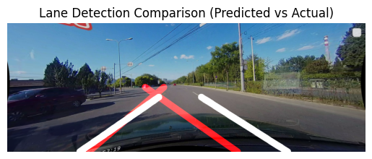
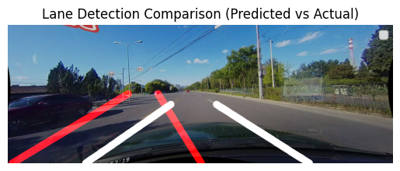
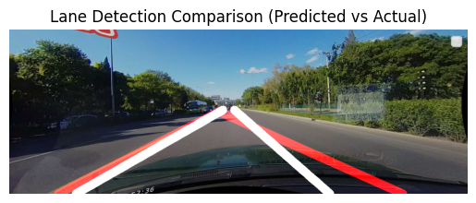

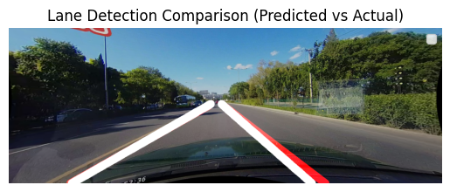
Lane Detection in Well Light Conditions
F1 Score: 0.2480 (With Preprocessing)
F1 Score: 0.3020 (With Preprocessing and Retinex)
F1 Score: 0.0329 (No preprocessing)
F1 Score: 0.3539 (With Preprocessing)
F1 Score: 0.7570 (With Preprocessing and Retinex)
F1 Score: 0.0049 (No Preprocessing)
RED LINE: Predicted
WHITE LINE: Actual (Annotated)

Slide 10
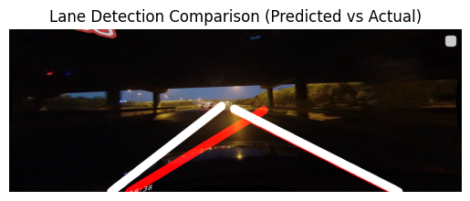
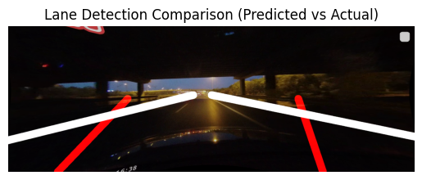
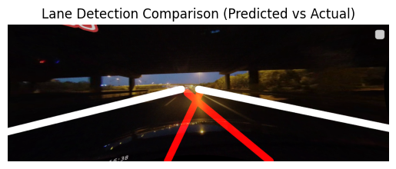
Lane Detection in Low Light Results
F1 Score: 0.0782(no preprocessing)
F1 Score: 0.0116(Preprocessing without Retinex)
F1 Score: 0.4905 (After preprocessing and Retinex)
RED LINE: Predicted
WHITE LINE: Actual (Annotated)

Slide 11
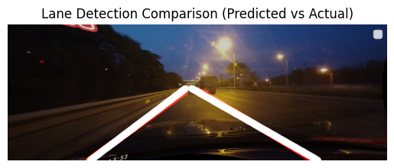
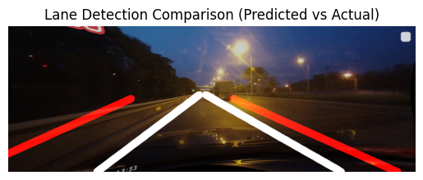
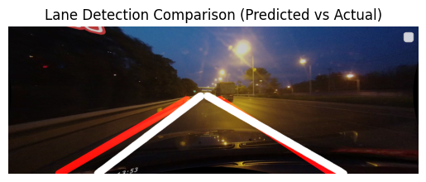
Lane Detection in Low Light Results
F1 Score: 0 (no preprocessing)
F1 Score: 0.3573 (Preprocessing without Retinex)
F1 Score: 0.8563 (After preprocessing and Retinex)
RED LINE: Predicted
WHITE LINE: Actual (Annotated)

Slide 12
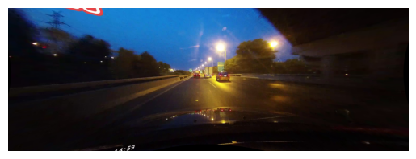
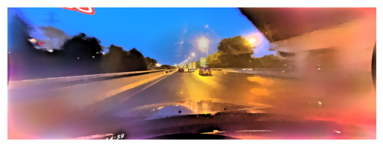
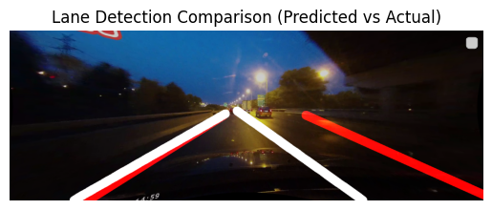
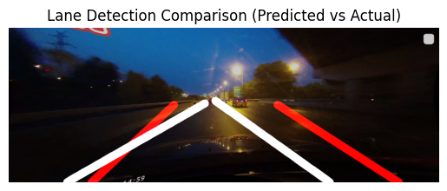

Example Retinex Output
F1 Score: 0.2788 (Preprocessed with Retinex)
F1 Score: 0.1227
(No Preprocessing)
F1 Score: 0.2330 (Preprocessed without Retinex)

Slide 13
Final Conclusions
Lane detection with Hough transform gives reasonable accuracy in daylight use case.
In low light conditions, accuracy of lane detection drastically reduces.
Improvement can be observed by using image enhancement methods after applying retinex to the image, like FSCS, Histogram equalization and Multiscale Retinex with color preservation methods.
Retinex methods resulted in the most improvement in detection.
However, bilateral filtering had to be used post enhancement due to increased noise.

Slide 14
Major Challenges
Defining a general image mask was difficult – different methods like using Otsu thresholding followed by dilation, rectangular and trapezoid definitions were used, with the trapezoid being more successful than the others.
Noise reduction before Canny edge detection was quite crucial and was challenging, especially in case of low light images.
Artifacts were being produced in the objects that were in the dark region of the image. Reduced the artifacts with bilateral filtering.
Major computation involved in multi scale retinex makes system infeasible for real time implementation.

Slide 15
Future Work and Ideas
Utilizing other datasets like TuSimple datasets focused on night time lane detection needs to be done
Testing with deep learning models to compare in terms of computation cost and accuracy

Slide 16
THANK YOU

